Slide 1
Dawn: Large-Scale Protein Multiple Sequence Alignment
Darrell O. Ricke, PhD
MIT Lincoln Laboratory

Slide 2
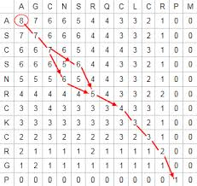
Outline
Challenges
  Exponential sequence data growth
  Exponential algorithms
    Two sequences – N² [Needleman-Wunsch, 1970]
    a naïve MSA takes O(Length^{Nseqs}) time to produce
Background on Proteins & current Dogmas
New Approach
Results - overturning Dogmas
Two Applications

Slide 3
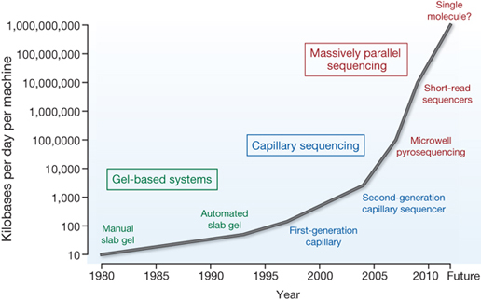
Rapid Sequence Data Growth
http://genome.wellcome.ac.uk/assets/wtdv027274.jpg
Sequence is Big Data
Most organisms have not been sequenced yet – tip of the Iceberg

Slide 4
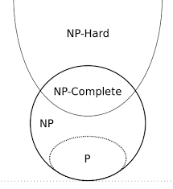
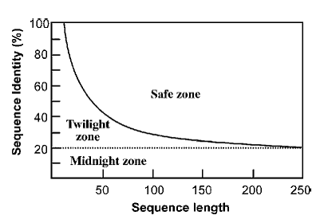
A Few Molecular Biology Dogmas
Protein multiple sequence alignment is an NP-Hard problem [Wang, 1994 Comp. Biol]
Protein sequences alone can not be aligned below a safe zone, named the Twilight Zone [Doolittle, 1986]
The Midnight Zone was established as the region where protein 3-D structure alignments are required for accuracy [Chothia, Lesk, 1986]
NP refers to "nondeterministic polynomial time"
Can a sequence method align sequences in the Midnight Zone?

Slide 5
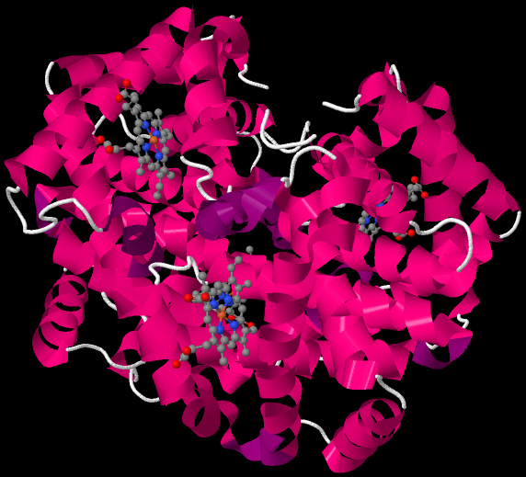
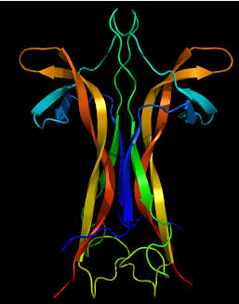
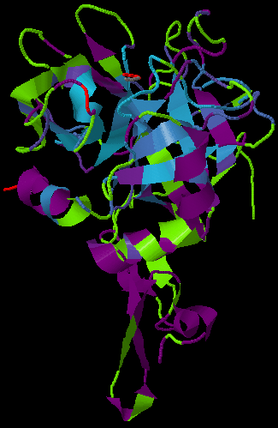
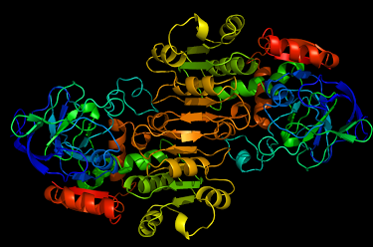
Example Protein Structures
Alpha and beta hemoglobin
Neurotrophin (Nerve growth factor (NGF))
Factor IX
http://beautifulproteins.blogspot.com/
Current methods over-gap alignments
Locations of amino acid residue insertions are deletions are constrained by protein structure and function [Pascarella & Argos, 1992].
Current sequence methods ignore this – can we do better?
Alcohol dehydrogenase

Slide 6
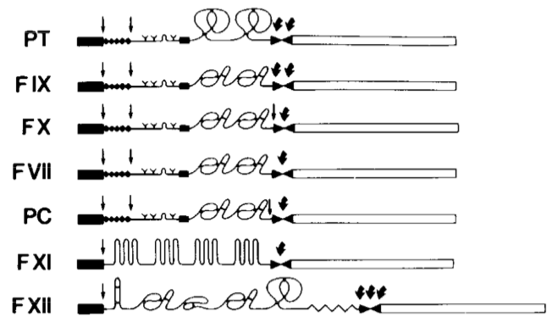
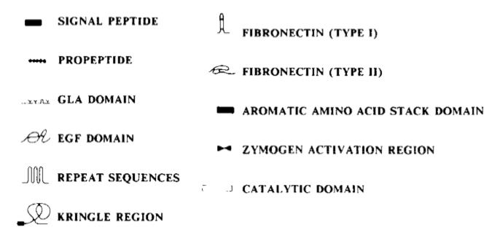
Proteins Building Blocks (Domains)
Furie & Furie, Cell 53, 1988
Possible to align full-length sequences of related genes

Slide 7
Proteins Building Blocks (Domains)
Furie & Furie, Cell 53, 1988
Possible to align full-length sequences of related genes
Possible to align common domains

Slide 8
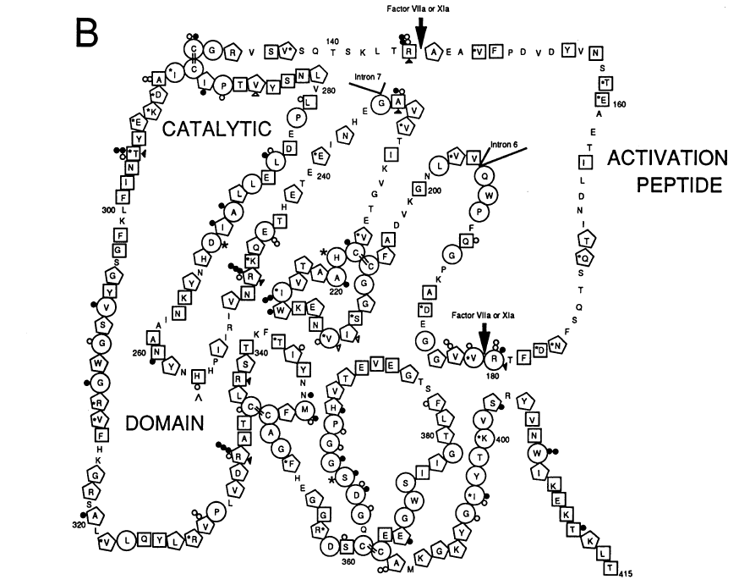
Factor IX Family Conservation
Higher conservation illustrated with more sides
Use clusters of conserved residues (residues with circles) as alignment anchors
Bottema et al. Am J Hum Genet, 1991,

Slide 9
Multiple Sequence Alignment Strategy
Identify common k-mers (short amino acid strings)
Select ordered k-mers as alignment anchors
  Reduction in dimensionality of the problem
Align segments between anchors – minimize alignment gaps
  Optimize gaps to overlap
Optimize alignment ends

Slide 10
Multigene Analysis
Factor 9, Factor 7, Factor 10, & Protein C
anchors
Amino Acid Position
De novo discovery of anchor points

Slide 11
Domain Alignment Example
Pos. Mer Count
105 GGS 52
228 VGG 56
239 PWQ 72
240 WQV 49
252 CGG 77
253 GGS 52
264 TAA 76
265 AAH 90
266 AHC 90
315 DIA 54
316 IAL 53
317 ALL 58
324 PLV 57
355 GWG 87
375 PLV 57
396 CAG 79
407 CQG 50
408 QGD 48
409 GDS 95
410 DSG 95
411 SGG 94
412 GGP 92
430 SWG 73
Automated identification of anchors

Slide 12
Alignment Over-gapping Problem
Problem: Current solutions over-gap alignments
  Gap creation penalty parameter
  Gap extension penalty parameter
Gap Minimization Strategy
Determine longest substring length between adjacent anchors
For shorter substrings, add the minimum number of gaps to the shorter substring and optimize identities

Slide 13
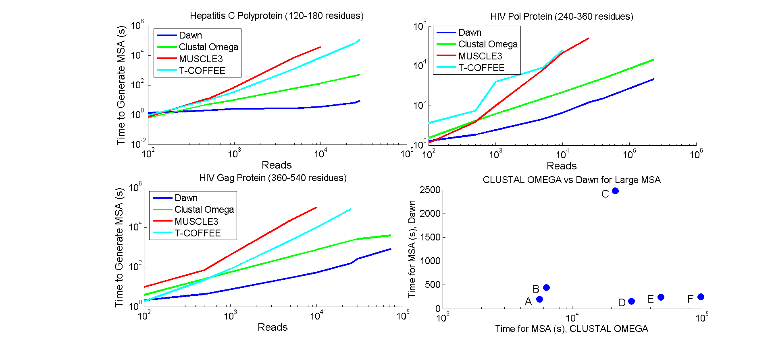
Performance Comparisons
X
✔
X
X
✔
✔
✔
✔
X
X
✔
✔
A: Influenza Na, 496 res., 51784 sequences
B: Influenza Ha, 566 res, 52443 sequences
C: HIV Env, 300 res, 209040 sequences
D: In Silico HIV Pol, 300 res, 1E5 seqs.
E: In Silico HIV Pol, 300 res, 1.5E5 seqs.
F: In Silico HIV Pol, 300 res, 2E5 seqs.
T-Coffee & MUSCLE3 failed on A-F datasets
Dawn – Fast Time Performance

Slide 14
Can Dawn Identify Virus Targets?
Target: Influenza A H1N1 – Hemagglutinin (HA)
Host Membrane
HA1
HA2
Virus membrane
http://www.rcsb.org/pdb/101/motm.do?momID=76
Influenza virus mutates rapidly
Can we align virus sequences from multiple strains to identify broadly neutralizing targets?
Notes:
Figure 3. Not cartoon

Slide 15
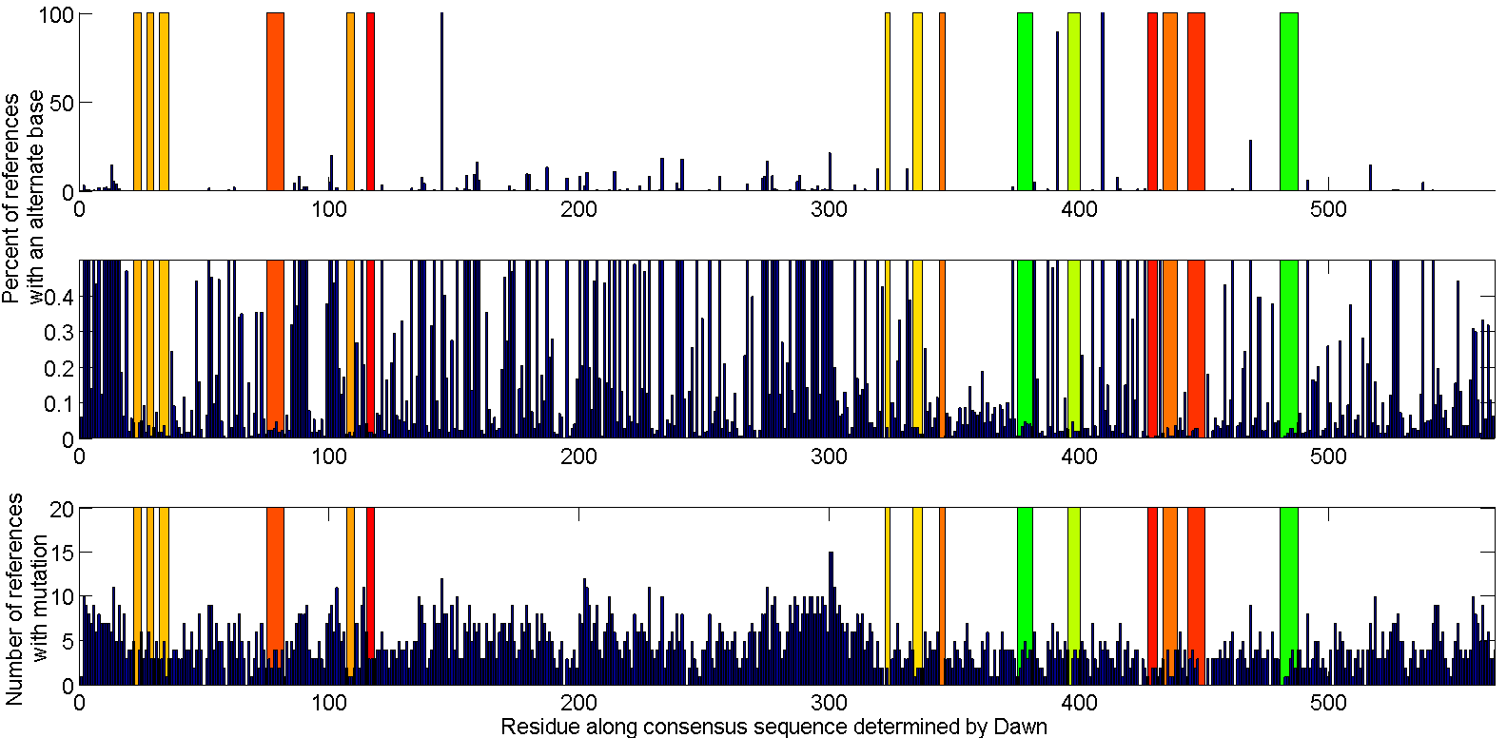
Virus Neutralization Strategy
43
203
330
457
Influenza A H1 - Hemagglutinin
ACC: Surface area that can be accessed by H20 molecule, Angstroms²
HA1
HA2
Candidates targets identified
Notes:
Figure 2. HA Variability analysis

Slide 16
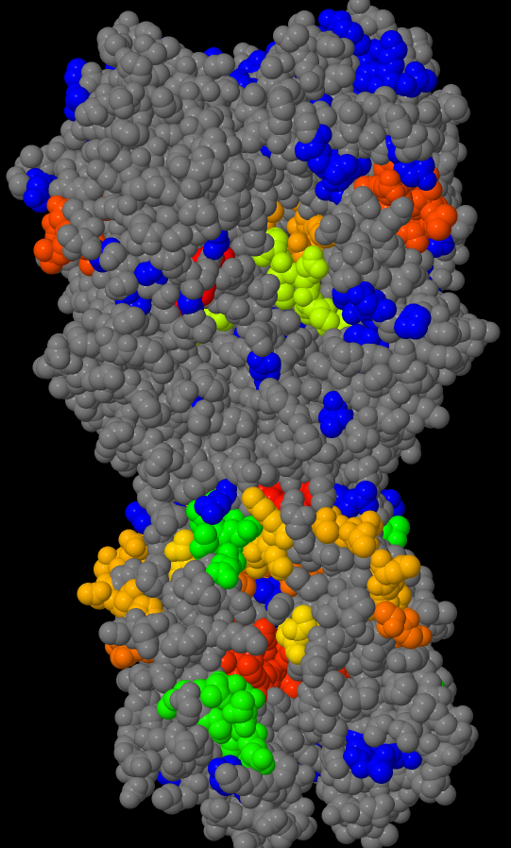
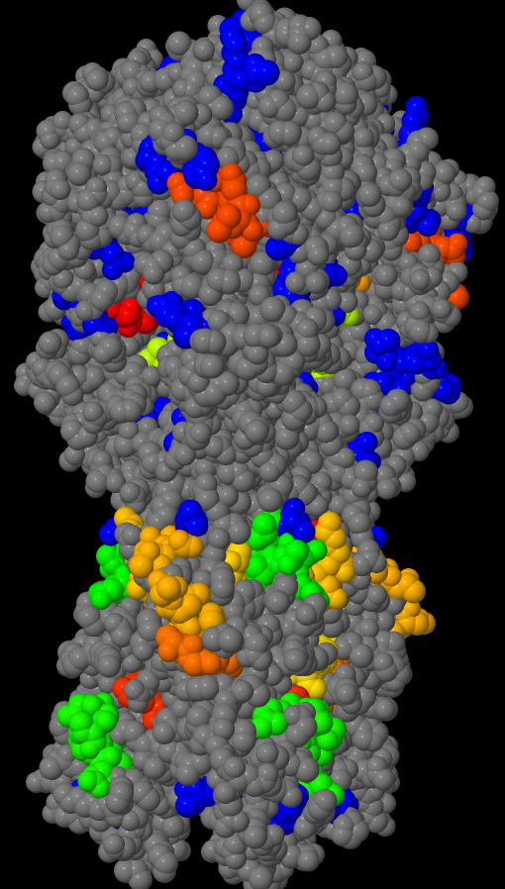
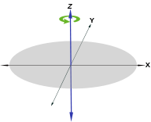
Select Surface Targets with Low Variability
Influenza A H1 - Hemagglutinin
Views of HA with 60° rotations about the Z-axis
43
203
330
457
ACC: Surface area that can be accessed by H20 molecule, Angstroms²
Non-conserved residues,
variability >=95%
Multiple Promising H1 Surface Targets
Notes:
Figure 3. Influenza A H1N1 HA potential broadly neutralizing peptide targets.
Symmetry!
Combine red/green, yellow goes to green
Surface residues blocked

Slide 17
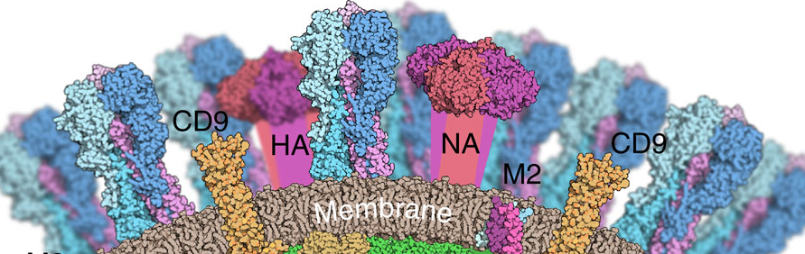
Second Target: Influenza - Neuraminidase
Host direction
Stalk
Viral membrane/stalk
http://www.nature.com/ncomms/2014/140916/ncomms5816/fig_tab/ncomms5816_F4.html
Current Influenza strategies target Hemagglutinin and Neuraminidase
- Exposed virus surface proteins
Notes:
Figure NA structure (lower right)

Slide 18
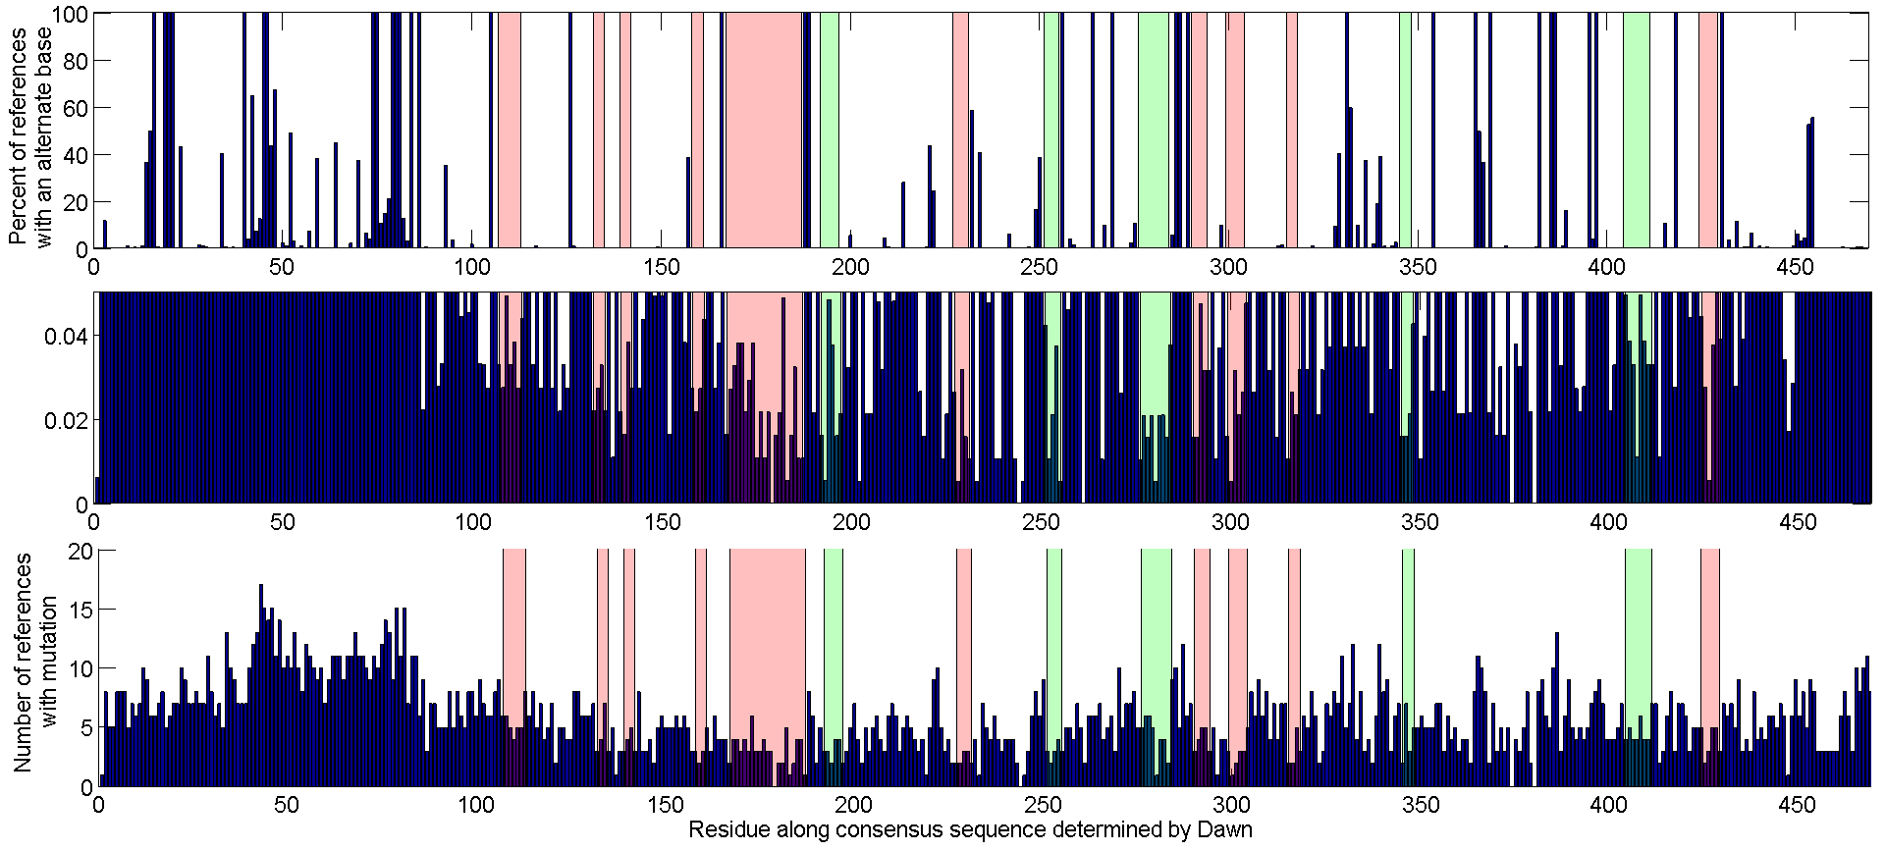
Influenza H1N1 - Neuraminidase
Conserved sites
Candidates targets identified
Notes:
Figure 4. Influenza A H1N1 NA variability analysis

Slide 19
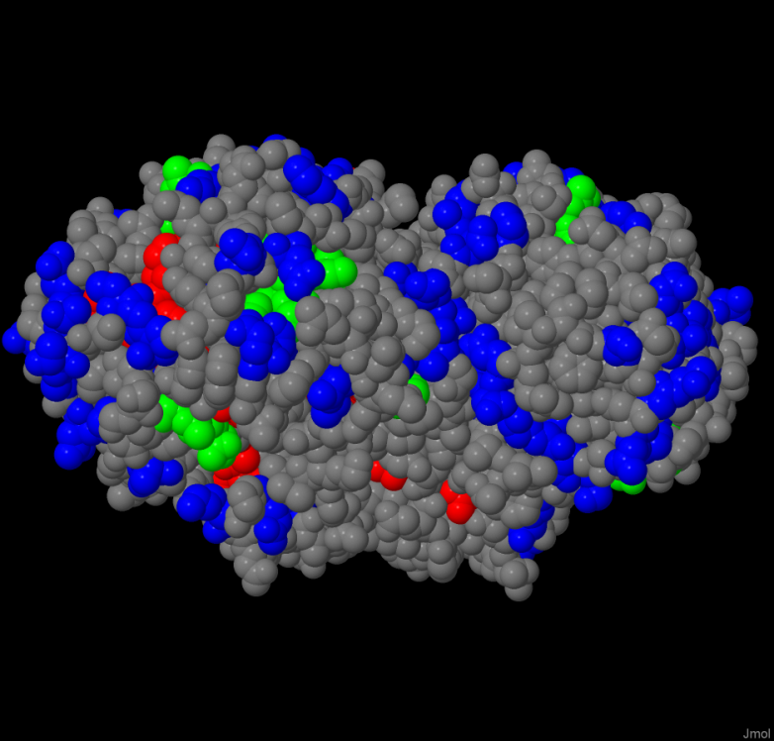
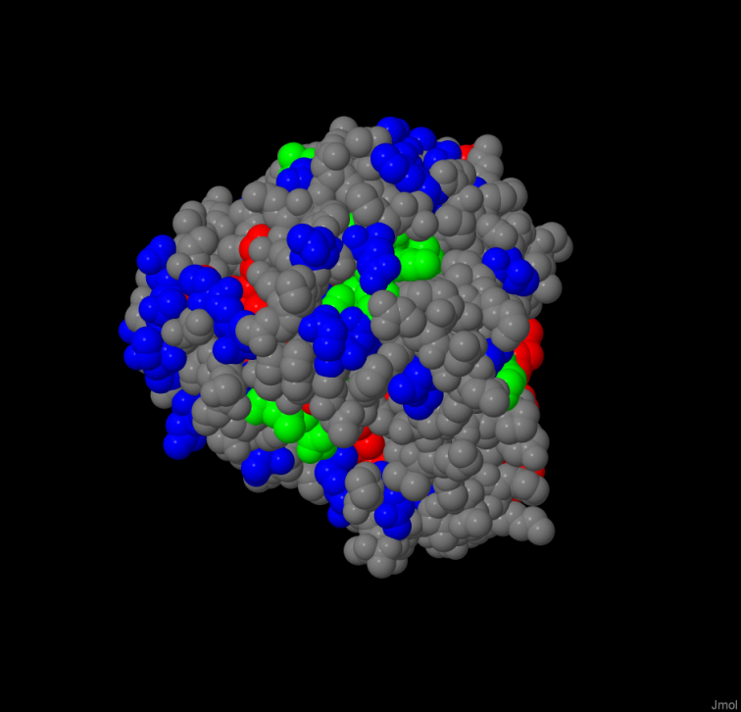
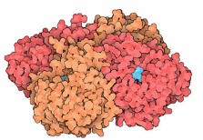
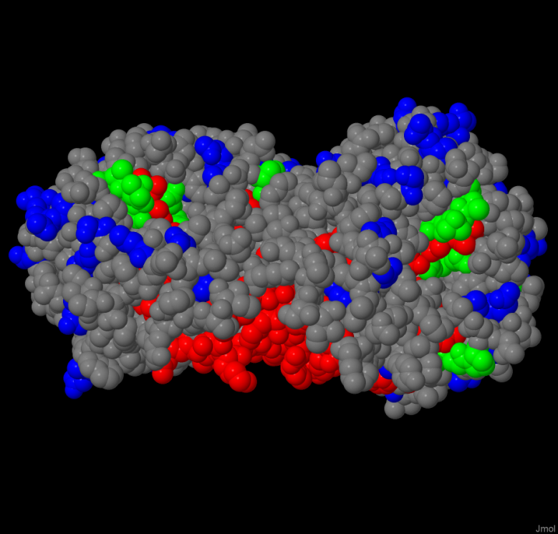
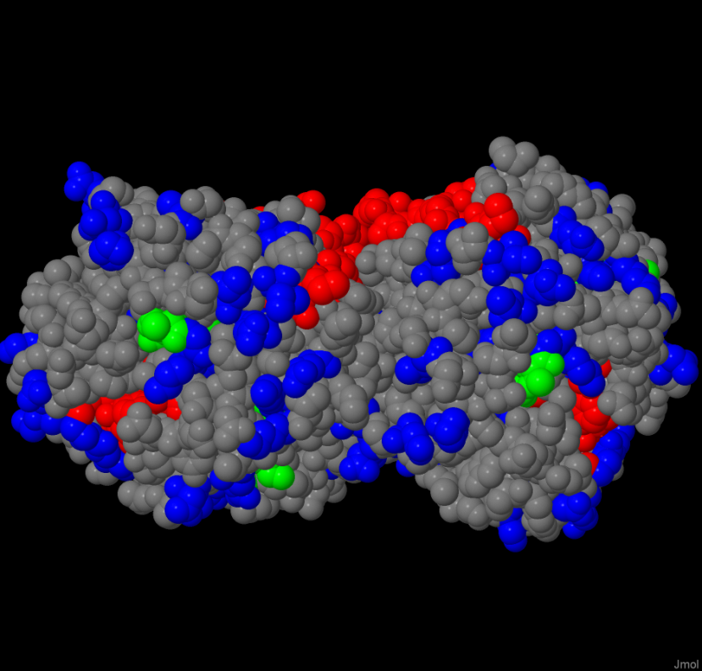
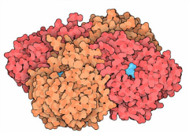
Influenza H1N1 - Neuraminidase
Outer surface
Rotate 90 degrees
Host-facing view
Stalk-facing view
Protein surface, conservation > 99.95%
Protein core/inaccessible, conservation > 99.95%
Conservation <=95%
N1 Surface Targets
Notes:
Figure 5. Influenza A H1N1 NA potential broadly neutralizing peptide targets.

Slide 20
Summary
Dawn
Fast (MSA problem not NP-hard?)
200K⁺ sequences
Aligns down to 5% sequence identity (deep into the Midnight Zone)
Applications
Virus targeting
Mutation analysis
Gene, family, & domain alignments
Open Source – approval at MIT
https://github.com/doricke/Dawn
Acknowledgements
Anna Shcherbina
Normalized Location Frequency
Kelley-Seegmiller syndrome & Lesch-Nyhan syndrome
HPRT mutations from [Cariello, 1994] HPRT database
Notes:
Figure 6. Normalized HPRT mutations location frequency by conservation level.

Slide 21
Backup Slides

Slide 22
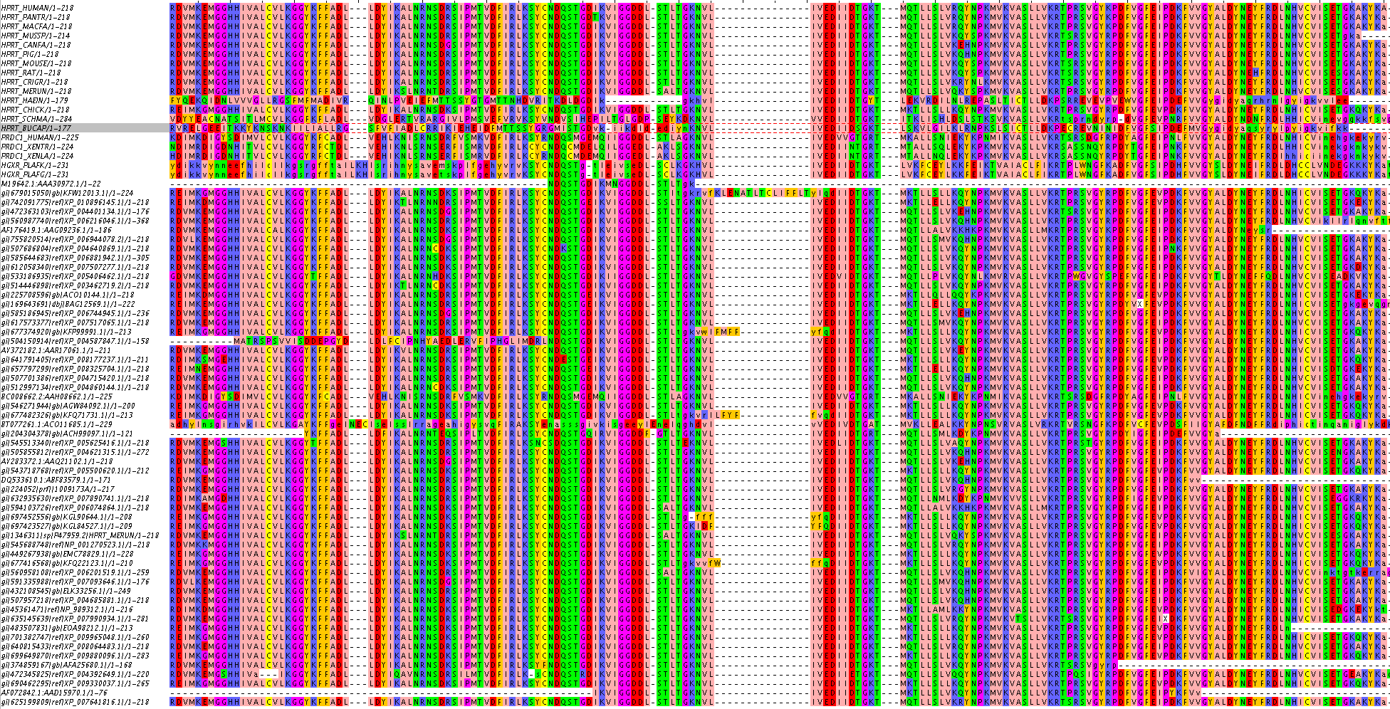
Dawn HPRT MSA
Multi-gene alignment that spans human to bacterial sequences

Slide 23
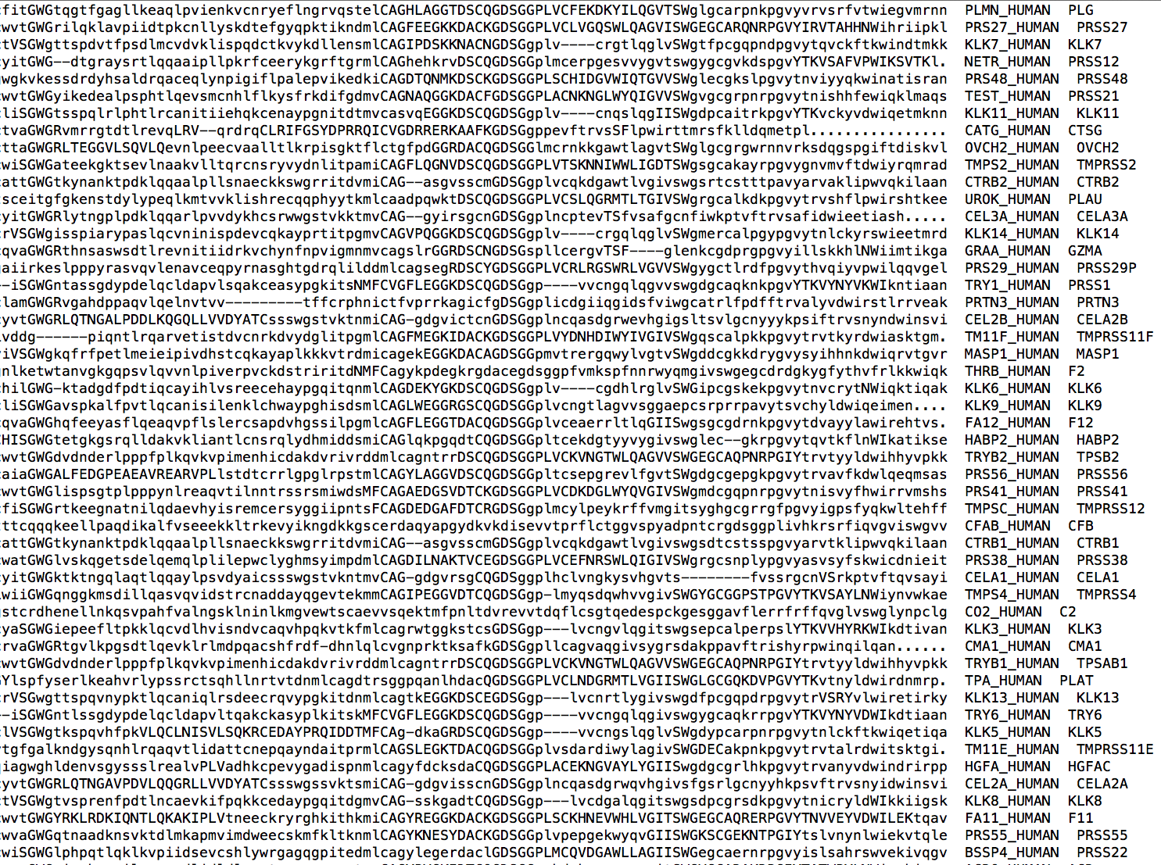
Example Dawn Pre-MSA Data

Slide 24
MSA Results Comparison Details
Notes:
Table 1.

